Slide 1
Software Development Life Cycle
Understanding the Software Development Life Cycle (SDLC) with
Case Study

Slide 2
Introduction :
SDLC stands for Software Development Life Cycle. The software development lifecycle (SDLC) is the cost-effective and time-efficient process that development teams use to design and build high-quality software.

Slide 3
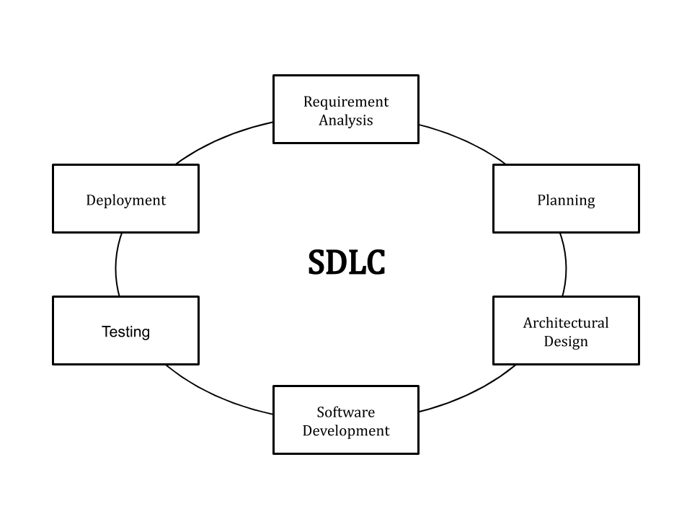
Phases of SDLC :
Requirement analysis
Planning
Software design such
as architectural design
Software development
Testing
Deployment

Slide 4
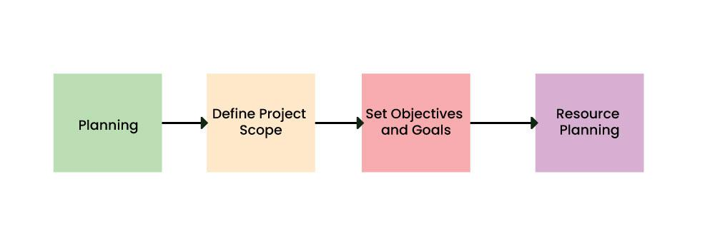
Planning and Requirement Analysis :
security requirements and appropriate security
choices .
It can mitigate potential threats and
vulnerabilities are identified in this stage.

Slide 5
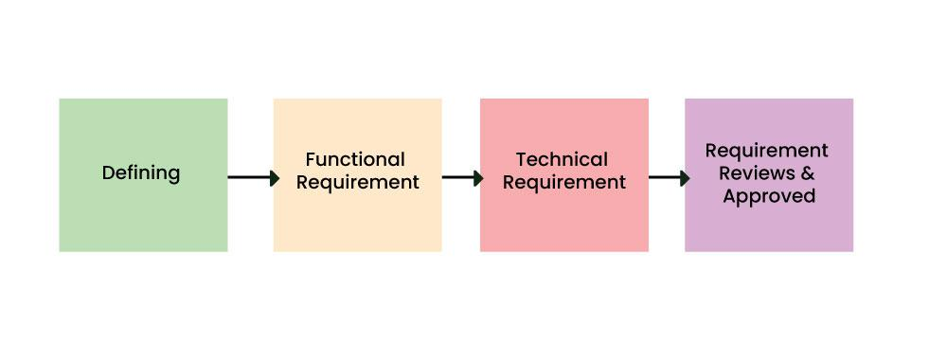
2. Defining Requirements :
The development team uses the security design
principle and architecture to consider potential risks.
This stage involves threat modelling, access control,
encryption mechanism, and architecture risk analysis.

Slide 6
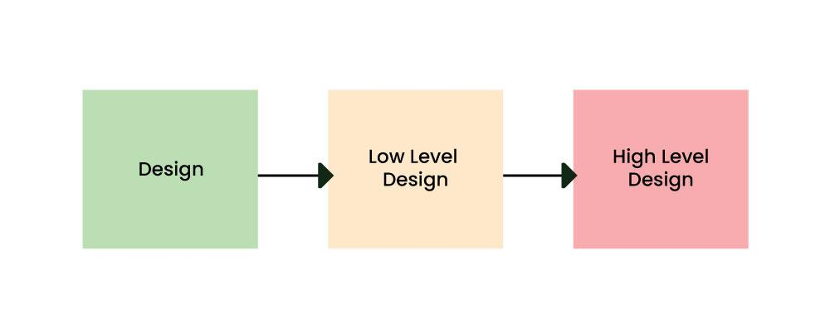
3. Design :
The code reviews are done to ensure software follows
code standards and security controls are
implemented.
Security vulnerability tests like penetration testing are
also done to identify potential issues.

Slide 7
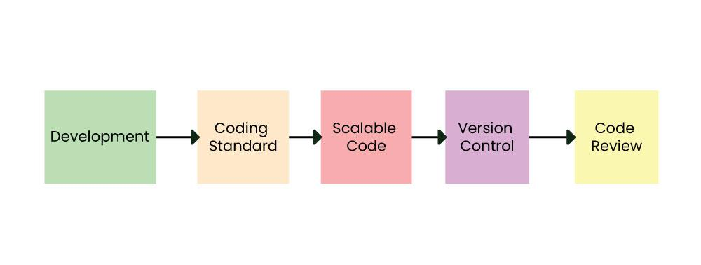
4. Deployment :
Automated DevSecOps tools are used to improve
application security.
To ensure the software is deployed securely, firewalls,
access controls, and security settings are configured.

Slide 8
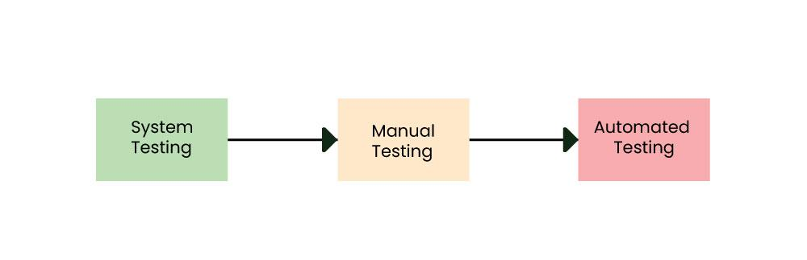
5. Product Testing and Integration :
testing of the software is necessary to ensure its smooth execution. Although, minimal testing is conducted at every stage of SDLC.
This ensures that the product confronts the quality requirements of SRS.

Slide 9
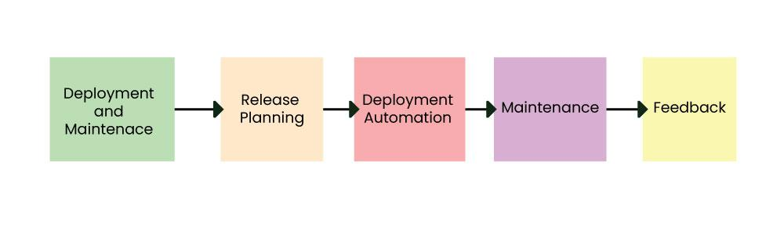
6. Deployment and Maintenance of Products :
it is tested in a real industrial environment. It is important to ensure its smooth performance. If it performs well, the organization sends out the product as a whole.
After retrieving beneficial feedback, the company releases it as it is or with auxiliary improvements to make it further helpful for the customers. However.

